Slide 1
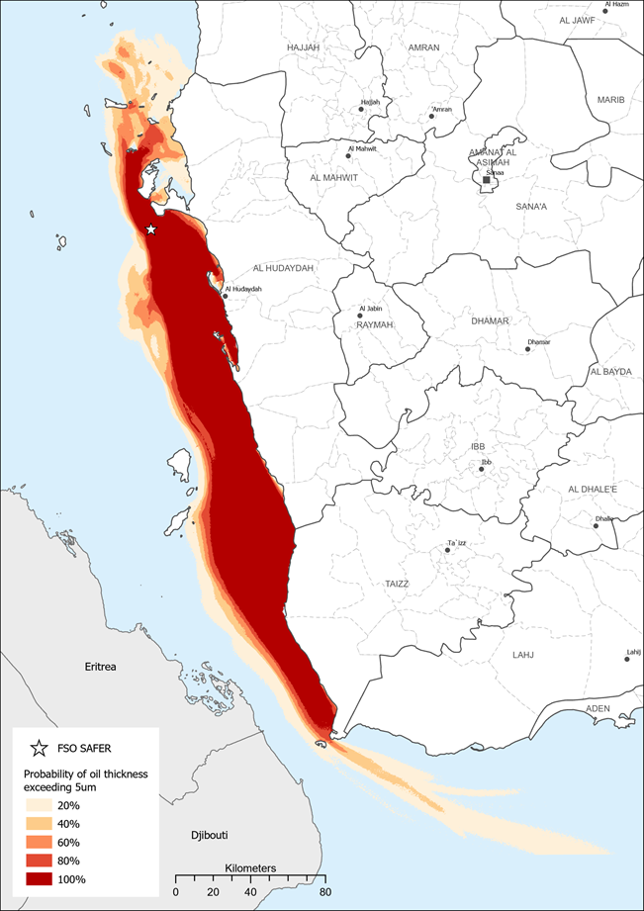
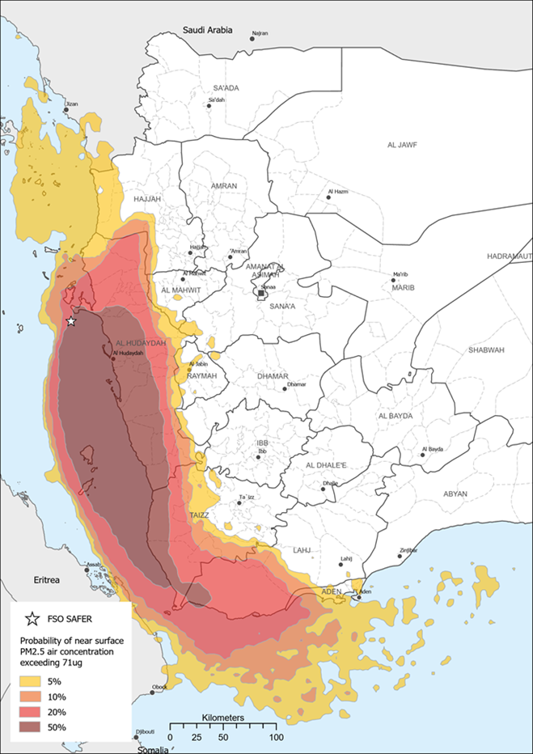
FSO SAFER Risk Impact Analysis – July to September
1. Oil spill impact
2. Very high air pollution impact as a result of a fire
Economic Impact
Economic Impact
100% of fisheries affected. $1.5bn lost income over 25 years
63,000 fisherman lose their livelihoods. Fishing stock could take 25 years to recover
500,000 people in the fishing and the seafood industry, and 1.7m dependents, will now need food aid
Al Hodeida port closes for 5-6 months. Fuel prices spike 200% interrupting health, water and sanitation services
Food prices double making more Yemenis reliant on humanitarian aid and increasing food insecurity levels.
40% of Yemen agriculture land(500 sq.km) agricultural land covered in soot
$70 million in lost agricultural production(grain, qat, fruits and vegetables)
3.25 million farmers lose their livelihoods for a year
60,000 out of work farmers and fishermen will likely move from the coast to Sana’a over 12 months looking for work and services
Health Impact
Over 8m people could be exposed to very high air pollution and require emergency and longer-term health care
People seeking treatment for respiratory illness overwhelm a healthcare system already struggling with COVID-19
Environmental & Humanitarian Impact
Environmental & Humanitarian Impact
Spill is four times larger than the Exxon Valdez. Recovery could take a quarter of a decade and potentially cost up to $20bn
Heavy contamination and pollution could extends as far as the Bab-el-Mandeb Strait, with some oil passing beyond into the Gulf of Aden
Over 8,000 wells are at risk of contamination, reducing access to water and increasing the risk of disease outbreaks.
Up to 60 humanitarian organisations could suspend services due to unsafe air, cutting services for 7 million people in need

Slide 2
Atmospheric dispersion (very high air pollution) as a result of fire onboard FSO SAFER – July-September projection

Slide 3
Oil spill from FSO SAFER - July-September projection

